Slide 1


Advanced course QA
How to test the website
WWW.ITEDUCATE.COM.UA

Slide 2


What is the web site?
www.iteducate.com.ua

Slide 3
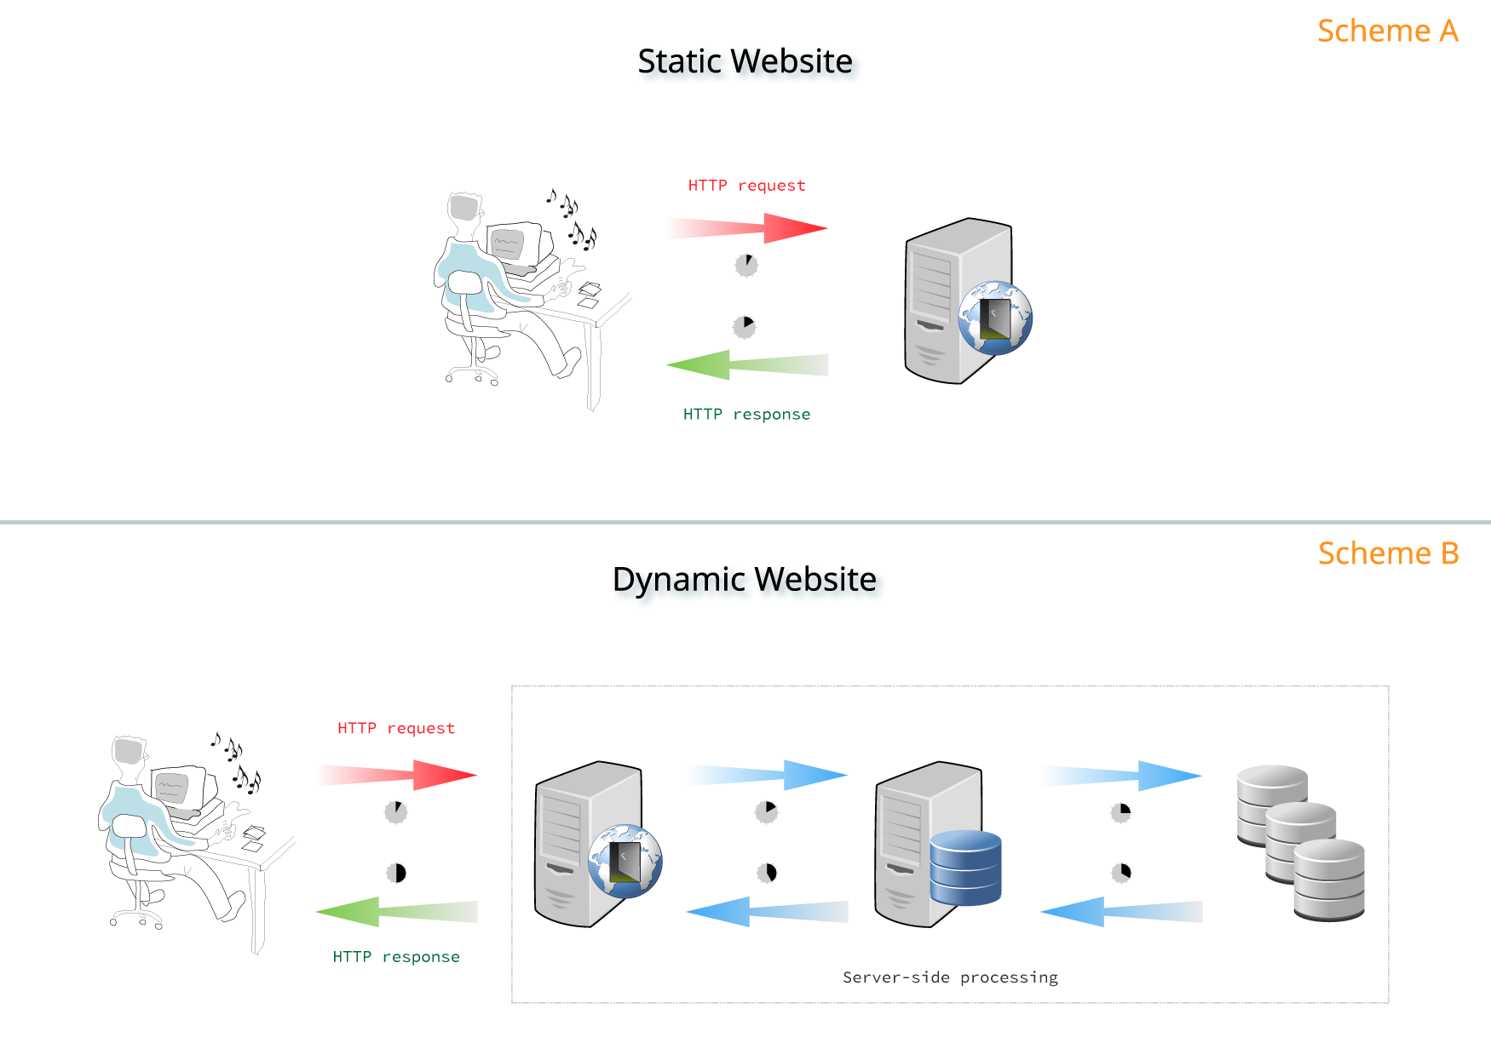
What kind of websites do we know?
www.iteducate.com.ua

Slide 4
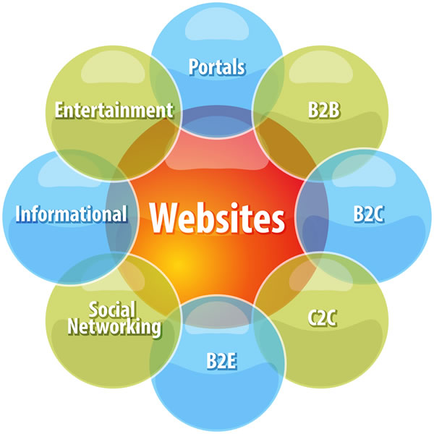
Types of websites
www.iteducate.com.ua

Slide 5
How do we test the website
www.iteducate.com.ua

Slide 6
Step by step
Requirements testing
Functional testing
Usability testing
Compatibility testing
UI testing
Performance testing
Security testing
www.iteducate.com.ua

Slide 7
LETS DO SOME PRACTICE
www.iteducate.com.ua

Slide 8
Tools that we use for testing Websites
Xenu's Link Sleuth
Selenium IDE (browser extension)
Browserstack
Reflector
CrossBrowserTesting by Smart Bear
Pingdom Website Speed Test
Google
HockeyApp and TestFlight
8
www.iteducate.com.ua

Slide 9

Home work
www.iteducate.com.ua

Slide 10
Advanced course QA
How to test the website
WWW.ITEDUCATE.COM.UA

